Slide 1
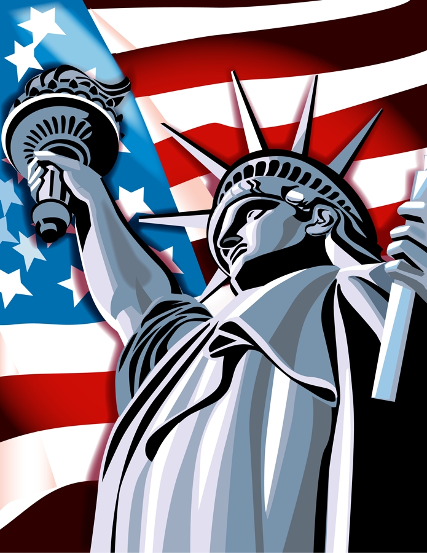
American Holidays
By: Gloria Montpeirous
SUNY Cortland – ICC 523
November 3, 2009
Table of Contents
NEXT

Slide 2
Throughout the year, Americans celebrate a number of holidays and national days of observances! Some are religious, secular, exclusively American, and even international.
Objectives
Cultural: Students will learn the various holidays and days of observances celebrated in the United States.
2. Vocabulary: Students will learn vocabulary words related to this topic.
United States of America
NEXT

Slide 3
Table of Contents
Secular Holidays
Religious Holidays
Exclusively American Holidays
International Holidays
Vocabulary
Quiz Game
Bibliography
Next

Slide 4
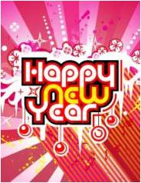

Secular Holidays and Observances
New Year’s Day
Mother’s Day
Valentine’s Day
Father’s Day
Halloween
Click here for picture to appear
Click on the pictures to learn more

Slide 5
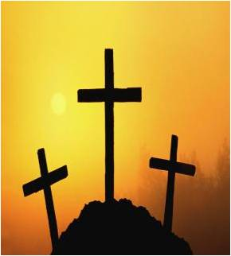
Religious Holidays
Christmas
Easter
Click here for picture to appear
Click on the pictures to learn more

Slide 6
New Year’s Day is January 1. Americans begins this celebration the eve before and wishes for a happy and prosperous upcoming year is expressed to family, friends, and strangers. Also, many people make New Year’s resolutions.
Martin Luther King Day is the third Monday in January. He was an African - American clergyman and a civil rights activist, who is recognized for his great contributions and efforts during one of the most try times in American history. He accomplished to win civil rights for all underrepresented people through nonviolence.
Groundhog Day is February 2 and has been observed since 1887. Many Americans gather to view if the groundhog will see his shadow after emerging from his burrow, if so, that means six more weeks of winter weather.
Valentine’s Day is celebrated on February 14. Many Americans use this day to express their love for their spouse and others by sending flowers, candy, and gifts.
Washington’s Birthday or Presidents’ Day is the third Monday of February. It honors the first president, George Washington and previous presidents of our country.
Easter falls on a Spring Sunday that varies yearly. This holiday celebrates the resurrection of Jesus Christ, our Savior. Many Christian Americans attend church services or mass and afterwards gather with family and friends for a great meal. Also, some follow old traditions of coloring hard-boiled eggs, giving baskets of candy to children, egg hunts for kids, and designing beautiful and colorful hats.
Earth Day is on April 22. It promotes ecology, encourage respect for life on earth, and highlight concerns over pollutions of the soil, air, and water. Since 1970, it has inspired American legislatures to pass the Clean Air and Clean Water Act.
Return

Slide 7
National Arbor Day usually on the last Friday of April but varies by state. This observance began in 1872, when Nebraska settlers and homesteaders were urged to plant trees on the largely treeless plains.
Mother’s Day is celebrated every second Sunday of May. Many Americans honor their mothers on that day by calling and sending flowers, gifts, and cards.
Memorial Day is the last Monday of May. It honors the many Americans killed in the Civil War and other wars and battles. Parades and special ceremonies are held to commemorate them. The American flag is flown throughout the nation.
Flag Day is June 14. This observance was presidentially proclaimed since 1916. Americans display the flag outside of their homes and businesses to honor the history and heritage of the American flag.
Father’s Day is the third Sunday of June. It began in 1909, but in 1966 the first presidential proclamation was issued to honor fathers in our country. Americans call and send cards and gifts to their fathers.
Independence Day is July 4. This holiday honors the Declaration of Independence on July 4, 1776 – the birth of our nation. Most Americans enjoy patriotic parades, picnics, barbeques, and a night of concerts and fireworks. The American flag is flown throughout the nation.
Labor Day is the first Monday of September. It honors the nation’s working people with parades. Americans view it as the end of the summer vacation and the beginning of the new school year.
Return

Slide 8
Columbus Day is the second Monday in October. It honors Christopher Columbus, the Italian explorer who discovered America on October 12, 1492. Several parades are held throughout our nation to remember him.
Halloween is celebrated on October 31. On that day, American children dress in costumes and go “trick or treating” by knocking on doors. The treats include candy and money. Some adults also dress in funny or scary costumes and attend parties.
Veterans Day is on November 11. This holiday honors veterans of all wars. Veterans’ organizations hold parades and the president places a wreath on the Tomb of the Unknowns at the Arlington National Cemetery in Virginia.
Thanksgiving Day is on the fourth Thursday in November. This holiday began in 1621, when the Pilgrims enjoyed a feast with the Native Americans who assisted them in receiving a bountiful harvest. This was the settlers way of showing their thanks and gratitude. Now, many Americans enjoy a feast with family and friends. The traditional foods serve at this meal includes turkey, cranberry, potatoes, green beans, and pumpkin pie.
Pearl Harbor Remembrance Day is December 7. This observance honor the 2,400 military service men and women who died on this date in 1941, during the surprise attack on Pearl Harbor, Hawaii, by the Japanese.
Christmas Day is on December 25. This special day marks the birth of our Savior, Jesus Christ. Many American Christians celebrate this day by sending cards, decorating their yards and houses with lights, putting up Christmas trees, attending church, giving gifts, and enjoying a great meal with family and friends. Many non - Christian Americans enjoy these same traditions also.
Return

Slide 9






Uniquely American
Martin Luther King Day
Washington’s Birthday
National Arbor Day
Memorial Day
Flag Day
Independence Day
Labor Day
Columbus Day
Veterans Day
Thanksgiving Day
Pearl Harbor Remembrance Day
Groundhog Day
Click on the pictures to learn more
Click here for names to appear

Slide 10
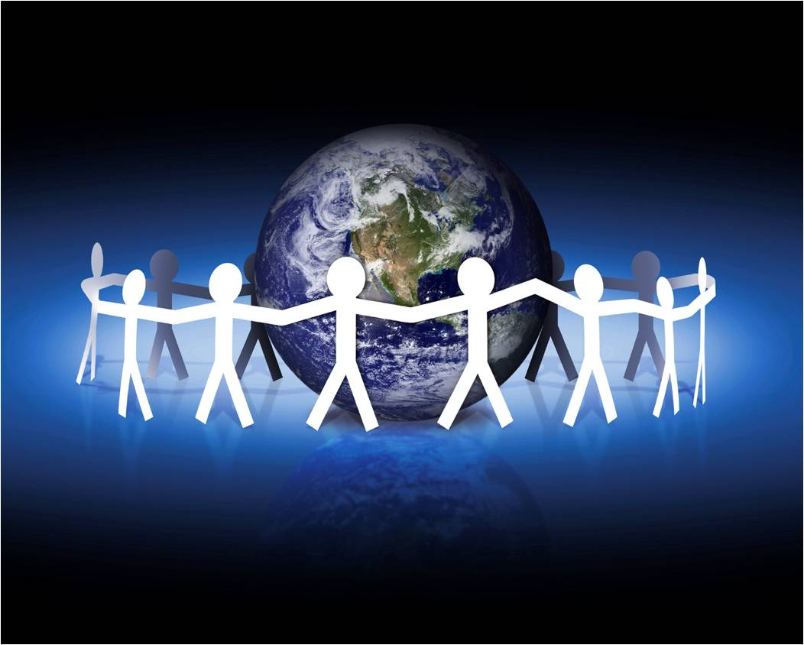
International Holiday
Earth Day
Click here for picture to appear
Click on the picture to learn more

Slide 11

Vocabulary - Definitions
Click on the sound icons to listen to the definitions
Holiday -
a religious feast day or a day fixed by a law or custom on which ordinary business is suspended in commemoration of some event or in honor of some person.
Secular –
of or pertaining to worldly things or to things that are not regarded as religious, spiritual, or sacred.
Observance –
a procedure, ceremony, or rite, as a particular occasion: patriotic observances.
Celebrate –
to observe (a day) or commemorate (an event) with ceremonies or festivities.
Cultural –
of or pertaining to culture or cultivation.

Slide 12
Holiday Quiz Game
Test Your Knowledge of Famous American Holidays?

Slide 13
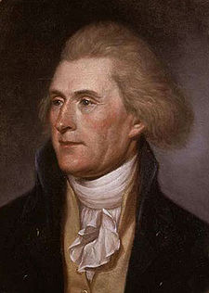
1. He was the first president of the United States of America and his birthday is in February?
Click on the Pictures
Thomas Jefferson
George Washington
Click here to go to the next slide

Slide 14
2. It is a Christian day of celebration. This religious holiday celebrates the resurrection of Jesus Christ?
Click on the Pictures
Easter
Valentine’s Day
Click here to go to the next slide

Slide 15
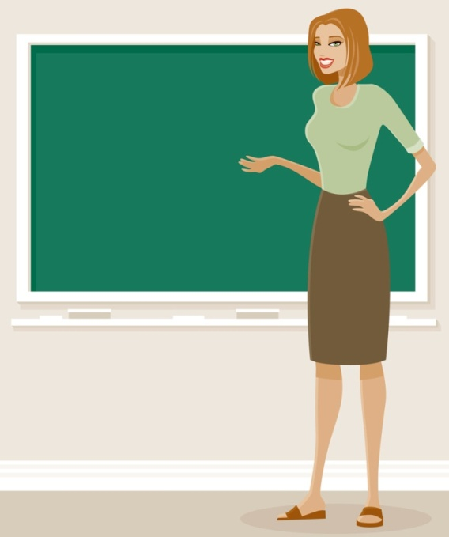
3.This observance is in Spring and it honors the most special woman in your life?
Click on the Pictures
Teacher
Mother
Click here to go to the next slide

Slide 16
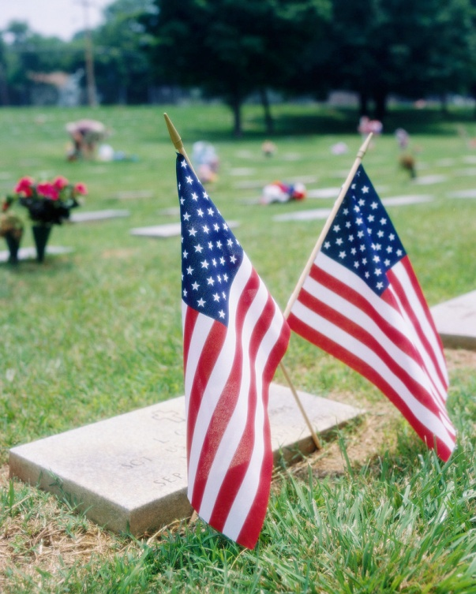
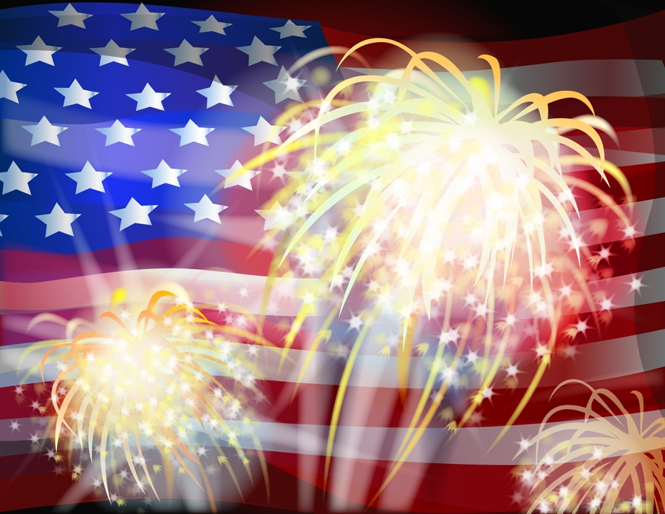
4. This day recognizes the men and women who paid the ultimate price for our nation?
Click on the Pictures
Independence Day
Memorial Day
Click here to go to the next slide

Slide 17
5. This holiday had its start in 1621 when the Plymouth colonists and Wampanoag Indians shared an autumn feast?
Click on the Pictures
Christmas Day
Thanksgiving Day
Click here to go to the next slide

Slide 18
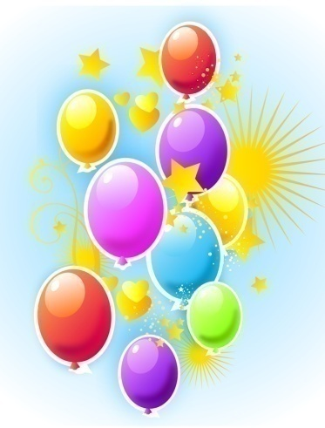

Great Job!
Hooray! You are a doing terrific!
Return to Questions

Slide 19
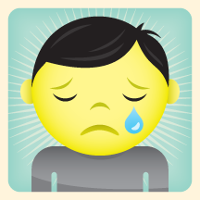
Sorry!
Try Again!
Return to Questions

Slide 20
Bibliography
http://www.usa.gov/citizens/holidays.shtml
http://office.microsoft.com/en-us/clipart/default.aspx?ver=12&app=powerpnt.exe
http://dictionary.reference.com/

Slide 21
THE END
HOME
Table of Content

